Slide 2
Emergency Stop Actuator Recall
Affected Products
Actuator inserts Emergency switch off / Emergency stop series 8602/1 from the delivery period of 01.01.2014 to 30.09.2016
Emergency switch off / Emergency stop switches 8003 series for panel mounting from the delivery period 01.01.2014 to 31.12.2016

Slide 3
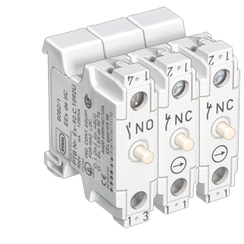
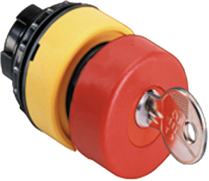
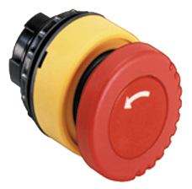
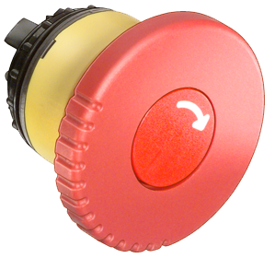
Emergency Stop Actuator Recall
Critical conditions: 8602/1 Actuators with EM Stop Function Application: Control Stations
Actuators are critical at temperatures below -15°C
Contact Elements are not affected

Slide 4
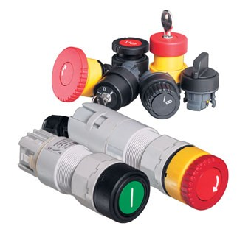
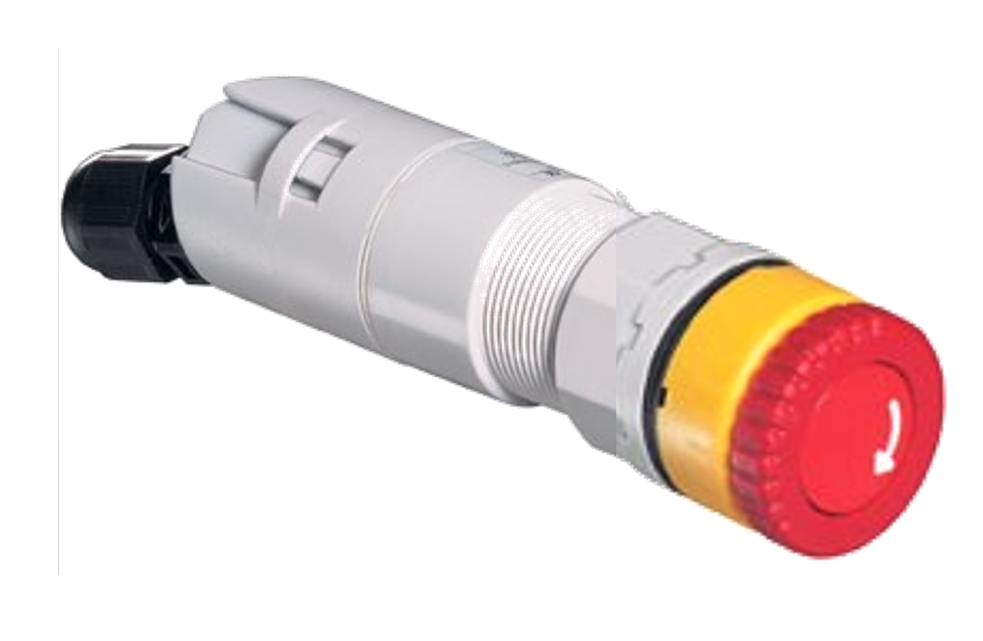
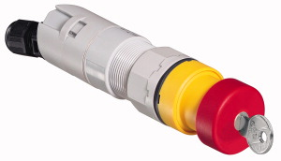
Emergency Stop Actuator Recall
Critical conditions: 8003 Panel Mount Devices with EM Stop 8602/2 Actuators
a fixing bracket
+
the actuator must generally be replaced
clamp must be added

Slide 5
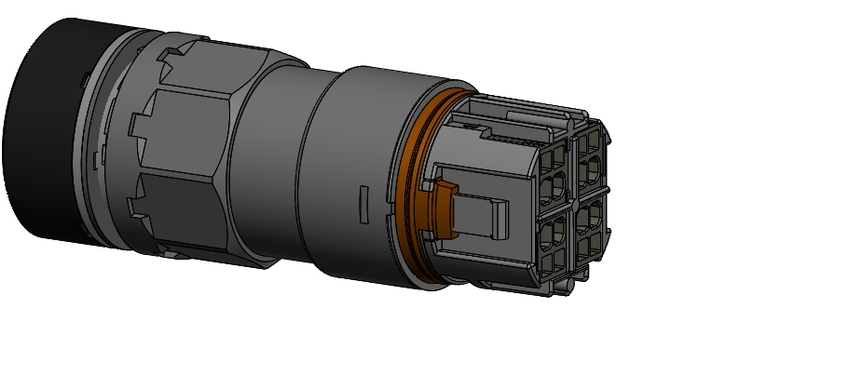
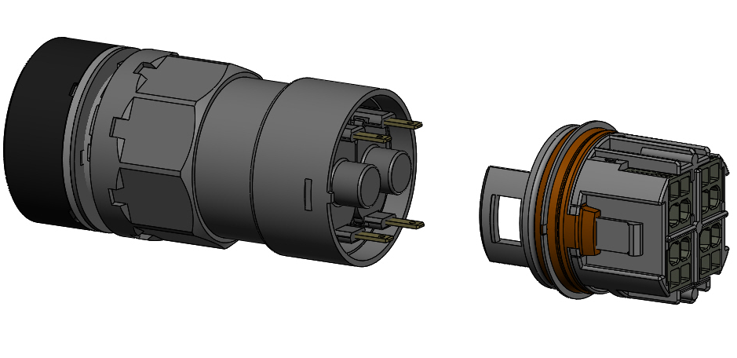
Emergency Stop Actuator Recall
Critical conditions: 8003 Panel Mount Devices with EM Stop 8602/2 Actuators
The two housing parts are not well latched in some cases:
Additional fixing brackets must be installed on versions
with and without connection cap

Slide 6
Emergency Stop Actuator Recall
Exceptions
When it is known that a production site does not have ambient temperatures below -15°C, a replacement of 8602/1 is not necessary
Only NBR sealing types are affected.
8003 must be fixed unexceptional.
→ further information can be found in the additional document “Criteria for assessing a risk when using 8602 actuators”

Slide 7
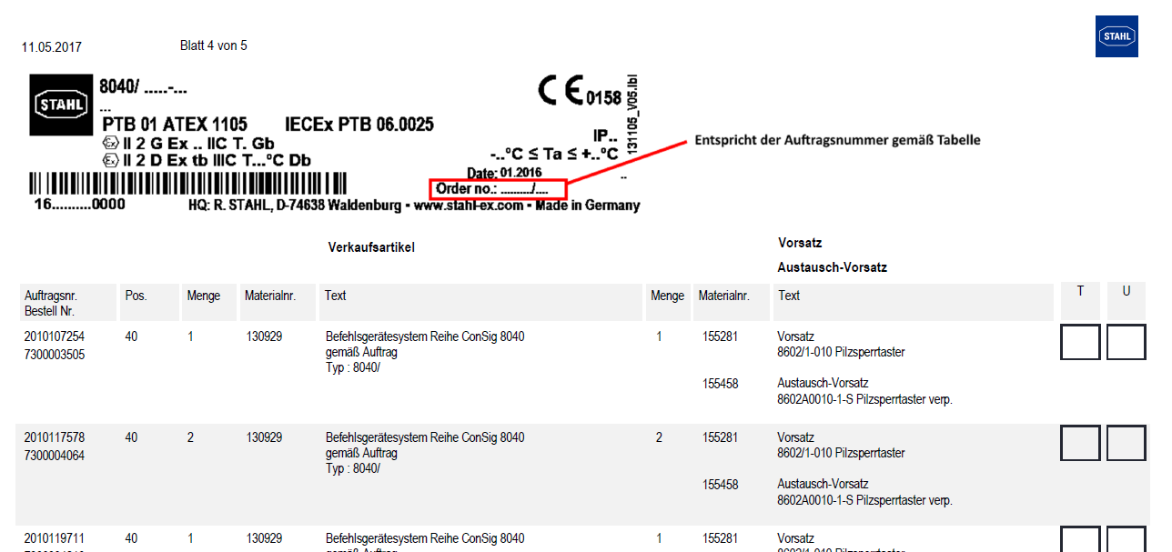
The List
Standardized Products must be identified by means of the serial number
Material number of replacement/
spare part(s)
Position on original order
Description of replacement/
spare part(s)
Tick here if you want to order the
replacement/spare part and send a
copy of the list to STAHL
Material number of item
Required amount of replacement
items
Tick here and send back to STAHL
to confirm that the replacement
is done
Description of the item
Order number of the original order
Number of items on original order
Ordnerumber same as number given in first column of table
Production Number 1380513 - 1394999
If the item was a single component (actuator solely)
no type label will be printed on top as it is unknown for us
where it is used → the localization of the item must be done
by the installer/user of the original item

Slide 8
Additional Support
Information homepage containing manuals and required documents. www.t-stahl.com/emergency.info

